Slide 1
Sentiment Analysis of Restaurant Reviews to Improve Customer Satisfaction
By: Hissa Alsaif

Slide 2
Outline
Introduction
Proposed Approach
Dataset Preprocessing
Model Construction
Visualization and analysis
Results
Conclusion

Slide 3
Introduction
Customer satisfaction is that expresses a customer’s feelings or attitudes about a particular product.
Key success in all types of business.
How to measures customer satisfaction?

Slide 4
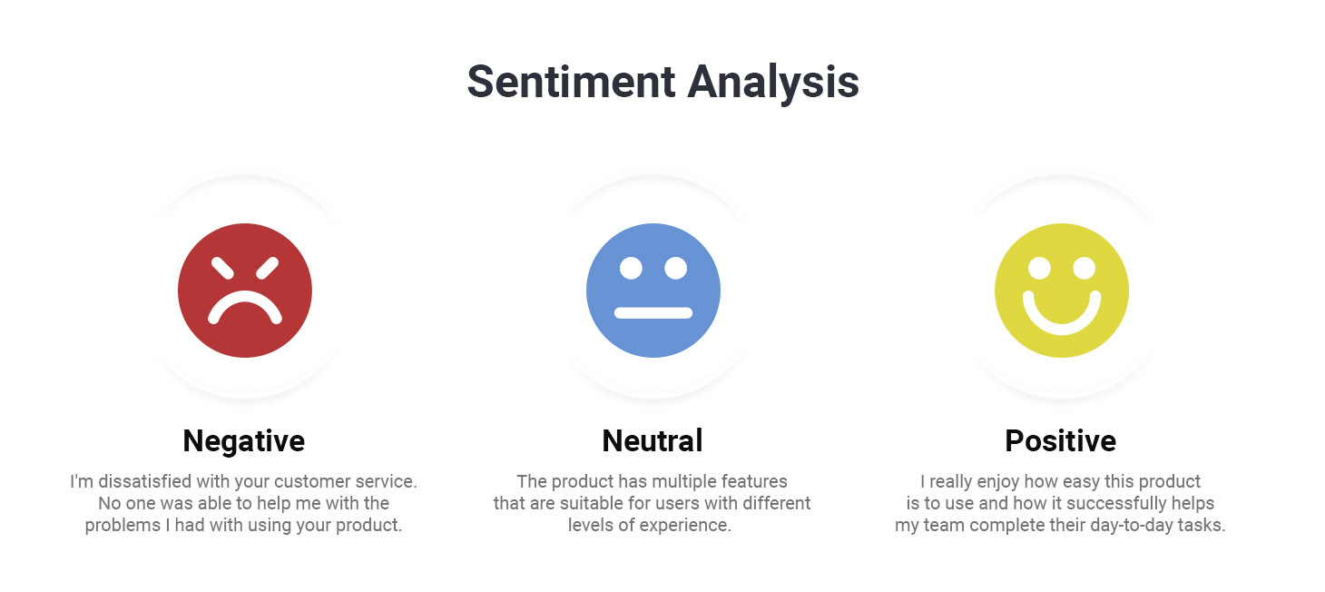
Introduction
Sentiment analysis
drive emotions and feelings about specific topics or brands.
This study has the following objective
Measure the extent of customer satisfaction with the services and products provided .

Slide 5
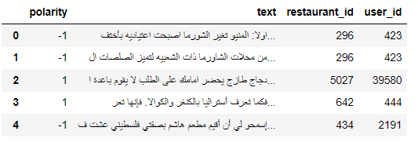
Dataset Example

Slide 6

Dataset Visualization

Slide 7
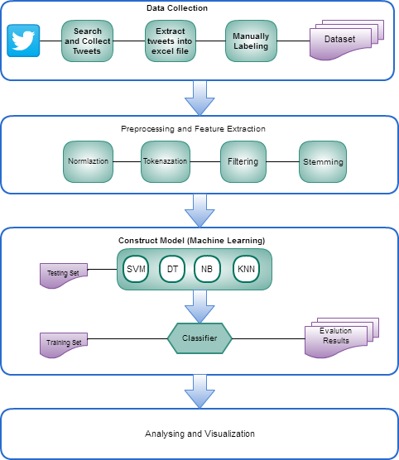
Proposed Approach

Slide 8
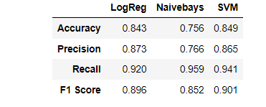
Model Performance

Slide 9
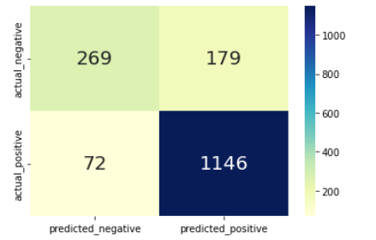
Model Performance

Slide 10
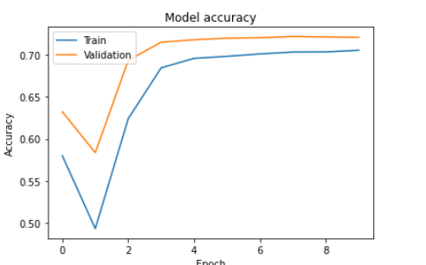
Model Performance

Slide 11
Conclusion
The best results are achieved by SVM that superior all traditional approaches as well as LSTM with a pretrained model.
This may be because of the limitation size in our dataset.

Slide 12
Thank you

